Slide 1

Università degli Studi di Milano
Statistical Learning
Danial Forouzanfar - 12988A

Slide 2
Supervised:
Decision Tree,
Random Forest,
eXtreme Gradient Boosting

Slide 3
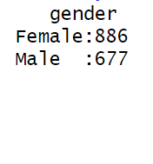
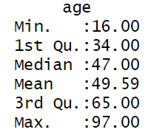
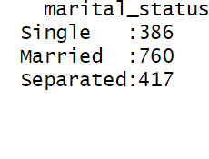
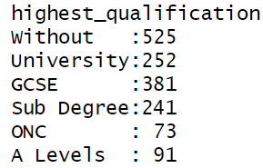
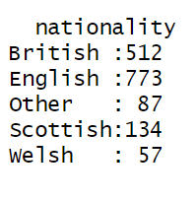
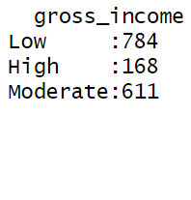
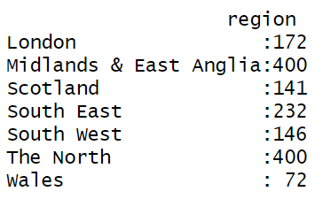
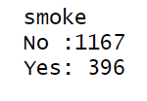
Data on smoking habits

Slide 4
Data
Preprocessing,
EDA
Decision Tree
Random Forest
XGBoost

Slide 5
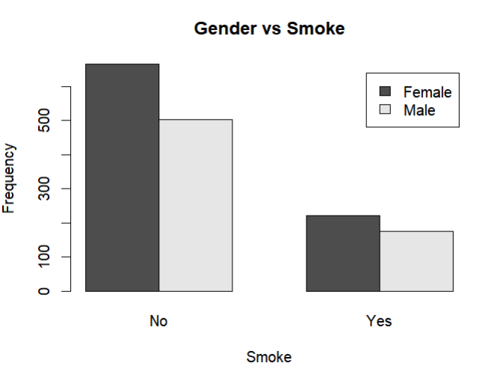
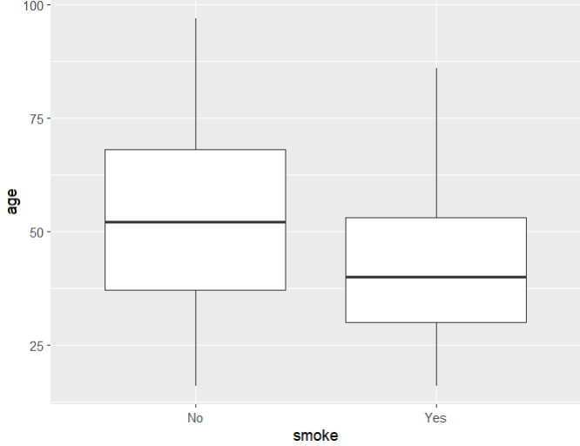
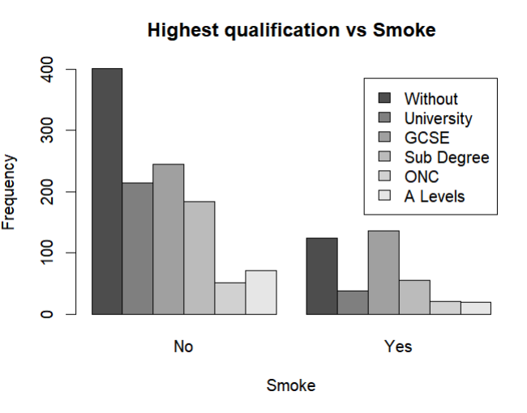
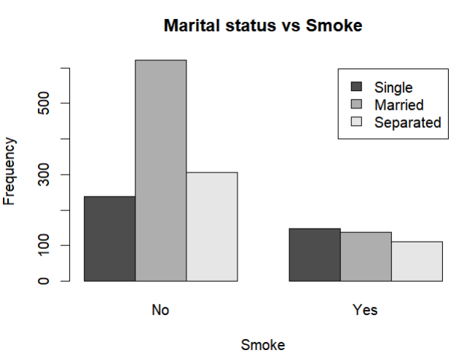

Slide 6
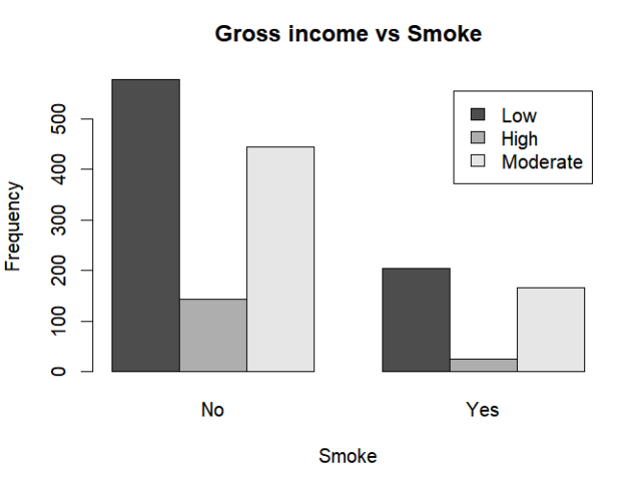
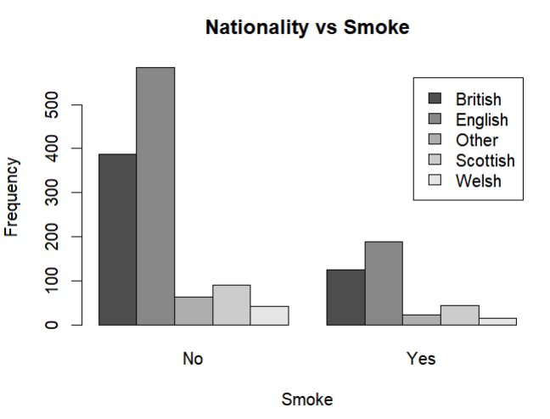
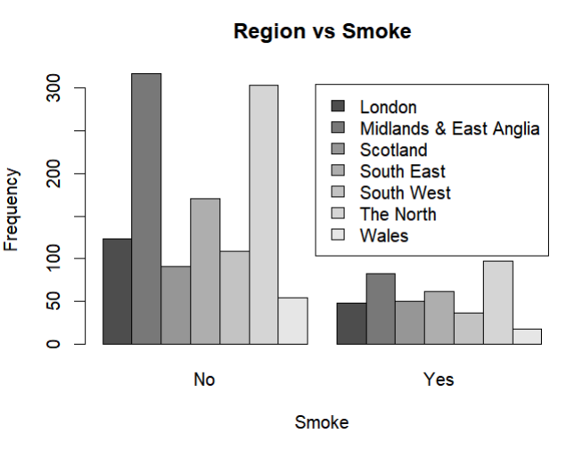

Slide 7
Libraries
General
Decision Tree
Random Forest
tidymodels
visNetwork
randomForest
tidyverse
rpart
e1071
caret
XG Boosting
xgboost
rattle

Slide 8
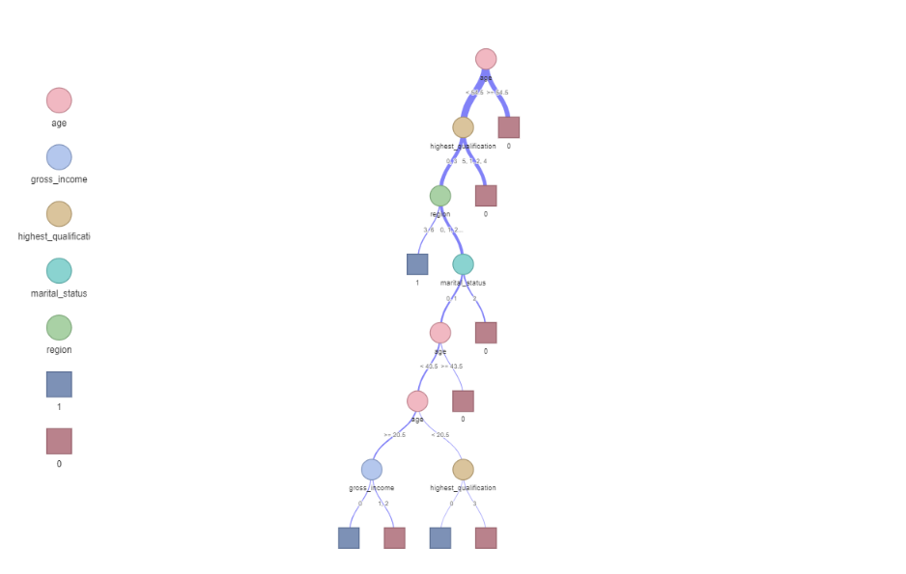
Decision Tree

Slide 9
Decision Tree
 | Metric | Value
1 | Accuracy | 0.7468085
2 | Precision | 0.9259259
3 | Recall | 0.7775120
4 | F1 score | 0.8452536

Slide 10
Random Forest
 | Metric | Value
1 | Accuracy | 0.7510638
2 | Precision | 0.9572650
3 | Recall | 0.7671233
4 | F1 score | 0.8817110

Slide 11
XG Boosting
 | Metric | Value
1 | Accuracy | 0.7595745
2 | Precision | 0.9743590
3 | Recall | 0.7668161
4 | F1 score | 0.8582183

Slide 12
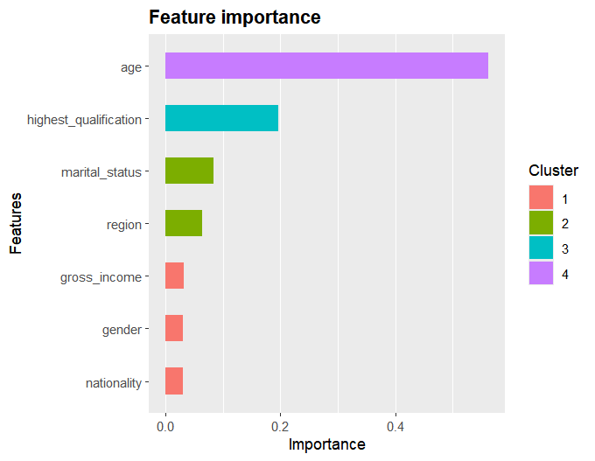

Slide 13
Unsupervised:
PCA

Slide 14
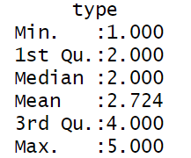
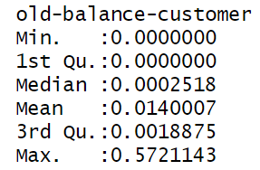
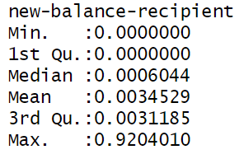
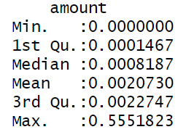
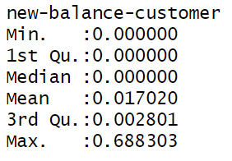
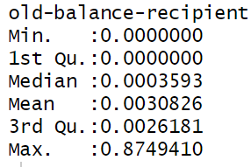
Fraud Detection

Slide 15
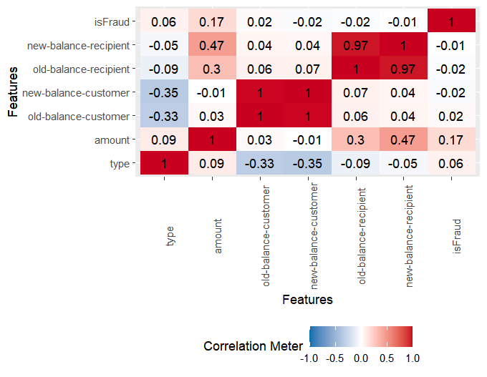

Slide 16
PCA
PCA
Method | Randomized
Transform | Standardize
K | 2
Threshold Level | 15

Slide 17
PCA
Eigen Values
Var | PC1 | PC2
Type | -0.261 | -0.274
Amount | 0.270 | -0.315
Old-Balance-Customer | 0.440 | 0.480
New-Balance-Customer | 0.438 | 0.487
Old-Balance-Recipient | 0.484 | -0.402
New-Balance-Recipient | 0.489 | -0.444

Slide 18
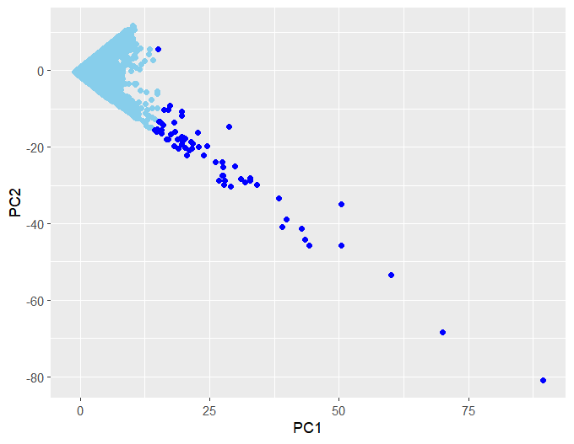
PCA

